Slide 1
Azure FinOps
Peter Perov

Slide 2
Azure FinOps
An Introduction

Slide 3
Agenda
Customer Scenarios
General FinOps Framework
Azure Specific Optimizations

Slide 4
Introduction

Slide 5
Why FinOps
?

Slide 6
Heavy Logging
$15k per month, +12 new PostgreSQL, turns on logging for audit purposes
Consumption grows +$4k (25%)
Mitigation:
logging is not auditing
use Change Data Capture for audit
reduce cost for logging ingest
Notes:
With happy ending
By about 25%

Slide 7
Next Gen
Organisation spends $70k per month
CTO is tasked with building next gen cloud app
Cloud spending goes up to $300k per month
CTO is fired
New CTO is hired and asks for our help
Notes:
I debated with my colleagues decision to fire the CTO but we couldn’t come a conclusion.
On one hand a person who made a mistake is more experienced than the person who didn’t
On the other hand controlling Cloud Spending is a responsibility of CTO, and he failed at that
I’ll leave it up to you to decide
But IMO controlling Cloud Spending is becoming CTO’s direct responsibility

Slide 8
Traditional purchasing process
Developer needs a thing, she creates a request
Request is approved by a management chain
Finance pays the bill
Developer gets a thing

Slide 9
Public Cloud
On-Demand
Scalable
Self-service
Measurable
Spending decisions are made by engineers
Notes:
Public cloud is great!
And a measurable per second spending report.
So the purchasing process on the cloud
Developer has keys to the cloud
Developer creates cloud resource
Resources incur charges
Cost gets out of control

Slide 10
Purchasing on the cloud
Developer has keys to the cloud
Developer creates cloud resource
Resources incur charges
Cost gets out of control
Notes:
So the
Developer has keys to the cloud
Developer creates cloud resource
Resources incur charges
Cost gets out of control

Slide 11
Risks
Technical Complexity
Micro-billing can be hard to understand
Different Languages (technical, organisational, business)
Lack of information
Human factor
Other priorities
Notes:
I can see the following risks in this scenario
Technical complexity – Azure itself has 500+ services all with at least 3 tiers of pricing
Micro billing can be a burden.
Human factor:
Overprovisioning
Wrong Licensing (Developer/Standard/Enterprise)
Other Priorities
(pushback)
Bad Actors
Crypto mining

Slide 12
Mitigation – Enter FinOps
FinOps – framework for managing, planning and accounting.
Combination of Processes and Technology
Financial accountability to the variable spend model of the cloud.
Make business trade offs between speed, cost and quality.
Notes:
It is necessary for an organisation to allocate, explain and control cloud spending.
FinOps terminology evolved over time:
Cloud cost management
Cloud cost optimization
Cloud financial management

Slide 13
What’s needed for FinOps?
Leadership support and influence
Stakeholder alignment
Communicate/Evangelise FinOps culture
Notes:
And general communication about FinOps culture across the organisation

Slide 14
FinOps Value
Accountability of usage pushed to the edge
Product teams manage their own usage against the budget
Decentralise resource usage and optimization decisions
Technical teams must consider cost as an efficiency metric
Just in time visibility of cloud cost to all levels
Fast feedback loops lead to behaviour change
Centralised FinOps reduces duplicated effort
Discount negotiation with cloud vendor is centralised
Continuous adjustments in cloud usage optimisation
Notes:
This slide explains the benefits of FinOps to the Technology Leadership
But I think it’s beneficial for our team as it lays out benefits of introducing FinOps in the organisation
* Decentralise resource usage and optimization decisions
To avoid situation where Finance buys a lot of cloud and no one uses it.

Slide 15
FinOps =
Real Time Reporting + Just-in-time processes + Teams working together
Notes:
FinOps cosists of three major pillars

Slide 16
FinOps role
Cross functional position
Mixture of Technical & Accounting skills
Authority, diligence, communication, evangelism, responsibility
Understanding Cloud Fundamentals and Cloud Pricing strategies
Raising cost awareness across organisation
Regular meetings with dept. managers/architects
Daily – go through daily usage and justifications
Weekly/Monthly – go through period usage and discuss spikes
Owns centralised cloud cost control model
Notes:
Part technical, part manager, part accounting

Slide 17
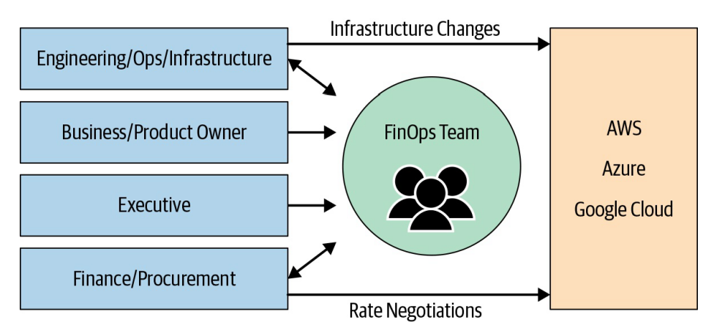
FinOps Role
Notes:
In the organisation topology
Somewhat centralised cost control model.
Having observed many FinOps teams I think that the best position for FinOps is under Chief Operating Officer (COO).
Engineers
Want to work on something meaningful and fun
Want to deliver software fast and reliably
Hate inefficiency and want efficient use of resources
Stay up to speed on the latest tech
Are measured by uptime
Want to deliver features, fix bugs, and improve performance
Would prefer not to worry about cost (but are responsible for incurring it)
Finance People
Want to accurately forecast and predict spending
Want to be able to charge back and/or allocate 100% of spending
Seek to amortize costs appropriately to the teams responsible
Want to split out shared costs, like support and shared services
Want to control and reduce costs, but maintain quality/speed
Want to help executives inform cloud strategy
Want to be aware of budget risks
Executives
Want to drive shared accountability to teams
Desire a digital business transformation
Want to shorten time to market for new services
Seek a competitive advantage
Want to establish a successful cloud strategy
Need to define and manage KPIs (key performance indicators)
Must prove the value of tech investments

Slide 18
Indirect Influence
Cant’ influence resource usage directly
But!
Can sit down with the team and understand the quality
Suggest optimization strategy
Understand the business value
Communicate the value to business stakeholders
Help make business decision what to do next (change the service pricing, make it a new product for the market)
Notes:
DBA refused to discuss low usage DB service ($100 monthly)
Pick a phone and call the person
Understand the reasoning and service importance
Communicate the importance
Show historical usage (only 100 per month, but 2400 over last 2 years)

Slide 19
FinOps analysis
Analyse Cloud Spending
Analyse Resource Utilisation
Rightsizing
Suggest service alternatives
Notes:
Real time reporting is a powerful influence on human behaviour.
Rightsizing - resizing cloud resources to better match workload requirements

Slide 20
Resource Inventory
Communicate the importance of tagging
Collective responsibility rather than individual (whole group/department)
Cost related tag for each department
Enforce tag existence with Azure Policy on creation
Scan all resources and tag them
Identify resource owner/creator
Who created what?
When was it created?
Does the owner still work in the organisation?
Report resource utilization
Notes:
Report Utilization
Usage metrics for each resource:
Number of connections
Compute utilisation (CPU, Memory)
Storage Utilization
To catch cases such as 2 weeks no one connected to the database. Why?

Slide 21
Culture Practise
Introduce the importance from the beginning (onboarding)
Regularly promote FinOps (why? And how?)
Continuously promote sustainability
Encourage resource conservation
Encourage engineers to consider resource cost
Notes:
We can consider FinOps as a Culture practise aimed at encouraging good behaviour.
Some examples of encouragement:
Department that saved on the cloud may receive additional funding for contractors or other vouchers.
Organization can provide vouchers to the teams who optimized their spending during the period.
Encourage good behaviour
Becomes another decision making parameter: Cost + Speed + Reliability

Slide 22
Human processes
Separation of responsibilities
Request approval process
Governance and Licensing
Continuous Review
Resource Utilization
Resource Necessity
Encourage good behaviour
Notes:
Engineer, engineering manager, departmental manager.
FinOps regularly meets with one of the engineering managers to discuss cloud spending over the period.

Slide 23
Why Separate Role?
Many resources created by multiple teams lead to disagreements who’s accountable for shared resources usage
Central person/team – can define and own metrics for everyone

Slide 24
Technology Processes

Slide 25
Azure specific tech processes
Preventive
Azure Blueprints
Azure Policies
Continuous
LMAA
Analysis + Review
Autoscale

Slide 26
LMAA
Collect information
Logging
Analyse
Monitoring
Notify
Alert
Mitigate
Action

Slide 27
LMAA Technologies
Logging
Azure Monitor
Alert
Alert Rule
Action
Alert Rule + Action
Blueprints + Policies
Monitoring
Log Analytics
Application Insights
Budget Alert
Cost Alert

Slide 28
Cost Alert
Budget Alerts
Credit Alerts
Department spending quota

Slide 29
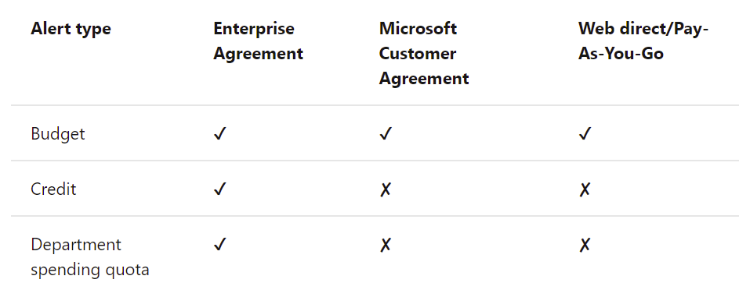
Alert availability per subscription type
Notes:
https://docs.microsoft.com/en-us/azure/cost-management-billing/costs/cost-mgt-alerts-monitor-usage-spending

Slide 30
Automation Examples

Slide 31
Tag usages
Tag “stop: never”
Daily automation task, stops every resource without the tag

Slide 32
Scanning
Scan all created resources – find out who created them

Slide 33
Real Time Reporting
How can we provide information that teams need to make a better decision?

Slide 34
Reasoning
Feedback
Understanding business impact
Accountability
Informed decision
Notes:
The effect of communicate spending back to the engineers can be dramatic. Feedback

Slide 35
Report granularity
Per resource group
Tags can be used to mark resources per Department/Project

Slide 36
Per Service Optimizations

Slide 37
Azure Pricing Structure
Compute
vCores
Storage
Size
Tier
Misc
Licensing
Traffic
Service Tier
Notes:
Generally for IaaS
Storage Tiers
Hot
Cold
Archive
Azure SQL Managed Instance service tiers
General Purpose
Business Critical
Azure SQL Database service tiers
General Purpose
Hyperscale
Business Critical

Slide 38
Traffic and Storage optimizations
Traffic
Region traffic is free, cross region cost money
Mitigation: package resource close to each other, reduce cross region traffic
Storage
Storage is cheap, however large number of unused VHD becomes an issue.
Mitigation: identify orphaned VHDs, optimize storage utilization

Slide 39
Azure SQL Optimizations
Pricing tier
Reservations
Azure SQL Elastic Pool (combine multiple dbs into one)
Scale up / Scale down on schedule
Reduce size of the data (move historical data to archive)
Manual schema/code optimizations
Notes:
Optimize your Azure SQL Managed Instance cost with Microsoft Azure Well-Architected Framework
https://techcommunity.microsoft.com/t5/azure-sql/optimize-your-azure-sql-managed-instance-cost-with-microsoft/ba-p/2235216

Slide 40
Dev/Test workload optimizations
Visual Studio Subscriptions, Azure Dev/Test
Azure credits
Cheaper resources
Dev/Test licenses
Dev/Test Licenses for SQL Server
Azure Dev/Test
Combines with Azure Reservations for further discounts
Notes:
Why Azure Dev/Test pricing?
https://azure.microsoft.com/en-us/pricing/dev-test/#overview

Slide 41
Azure VM Optimizations
Azure Reservations (1 year, 3 years)
Size optimizations
Scale optimizations
Vertical scale – requires a reboot
Horizontal scale – add/remove VMs as needed
Shutdown VM (predictable load pattern)
Azure Spot Instances (for certain workloads)
Notes:
What are virtual machine scale sets?
https://docs.microsoft.com/en-us/azure/virtual-machine-scale-sets/overview
Use Azure Spot Virtual Machines
https://docs.microsoft.com/en-us/azure/virtual-machines/spot-vms

Slide 42
Storage optimization
Use Standard HDD for less demanding workloads
Premium HDDs for more demanding workloads
Tiered storage (hot, cold, archive)

Slide 43
Azure Functions – Pricing plans
Consumption
Pay per use
Autoscale
Premium
Pay per use
Higher usage
Dedicated
Dedicated Compute
User Scale
Low usage
Prewarm instances
Autoscale
Notes:
Azure Functions hosting options
https://docs.microsoft.com/en-us/azure/azure-functions/functions-scale#scale

Slide 44
Azure Monitor
Pricing
Ingested data
Stored data
Optimizations
Minimise ingested data (only data you need)
Reduce retention period
Archive old data

Slide 45
App Service
Autoscale
Multiple websites in a single App Service Plan
Cost Analysis
Budget Alerts (per scope)
Cost Alerts

Slide 46
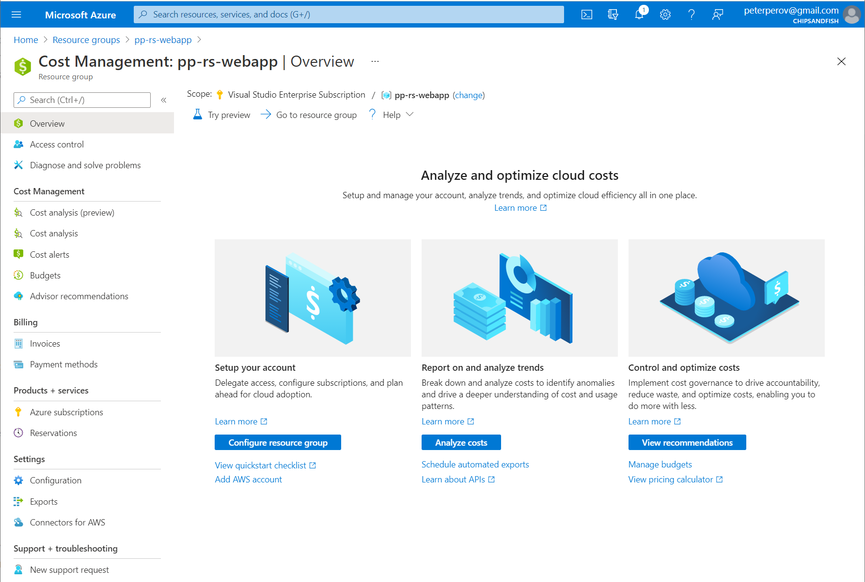
App Service Cost Analysis

Slide 47
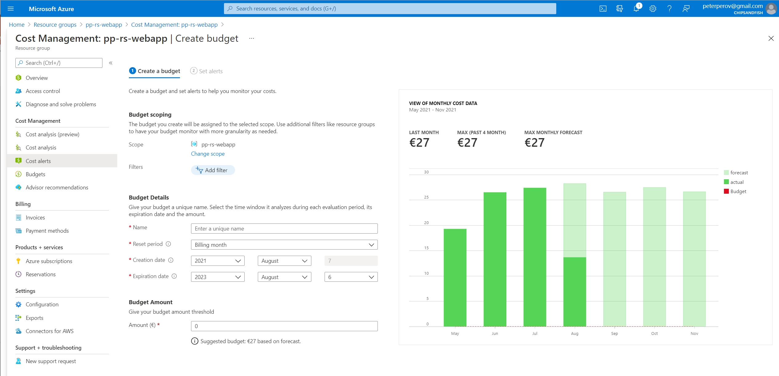
Cost Alerts

Slide 48
Traffic
Ingress traffic is free, egress traffic is not
Traffic “inside” region is free, between regions is not
Consolidate “heavy traffic” resources inside the region
Minimise cross-region traffic

Slide 49
Conclusion

Slide 50
Further Reading
O’Reilly, Cloud FinOps: Collaborative, Real-Time Cloud Financial Management
FinOps Foundation, https://www.finops.org/
Notes:
O’Reilly, Cloud FinOps: Collaborative, Real-Time Cloud Financial Management
https://www.amazon.com/Cloud-FinOps-Collaborative-real-time-management/dp/1492054623

Slide 51
Azure Policies Examples
Limit vCores available for Developers
Limit resources available for creation
Enforce tag creation with an error message
Cost center tag
Shutdown: daily/weekly/never tag
Certain tags can only be added by a trusted group
Notes:
There are 500+ Azure Services available for creation, it’s easier to disable everything and only allow necessary resources.

Slide 52
Resource Scanner
Scan all resources without tag
Utilization and logging

Slide 53
Demo Azure Monitor?
Log information
Create Alert

Slide 54
Demo Azure Blueprints and Policies

Slide 55
Demo Azure Budget
Notes:
Use cost alerts to monitor usage and spending
https://docs.microsoft.com/en-us/azure/cost-management-billing/costs/cost-mgt-alerts-monitor-usage-spending

